Slide 1

Chandigarh University
Department of Mathematics
B.Tech. CSE (Core/DS/IT/CC)
Semester-3
Subject Code:25MTT-202
Discrete Mathematics
Chapter:1.2.1
Dr. SARTAJ
DISCOVER . LEARN . EMPOWER

Slide 2

CO mappings

Slide 3

CO-PO mappings
Note: Degree of relevance/correlation: 1-Low, 2-Medium, 3-High, Blank or ‘- ‘- Nil

Slide 4
Topics Covered
Logical equivalence
Quantifiers: Universal and existential
Conclusions
Video links
References

Slide 5
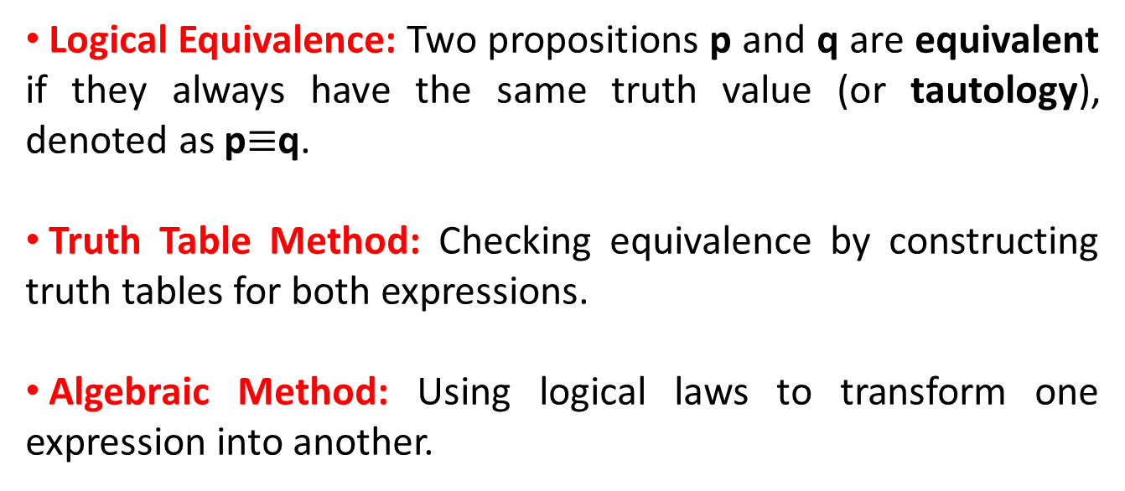
Propositional Equivalences
Logical Equivalence: Two propositions p and q are equivalent if they always have the same truth value (or tautology), denoted as p$≡$q.
Truth Table Method: Checking equivalence by constructing truth tables for both expressions.
Algebraic Method: Using logical laws to transform one expression into another.

Slide 6
Propositional Equivalences
Propositional Equivalences:
Two statements X and Y are logically equivalent if any of the following two conditions hold −
(I)The truth tables of each statement have the same truth values.
(II)The bi-conditional statement X⇔Y is a tautology.

Slide 7
Propositional Equivalences
Example: Show ¬(A∨B)and[(¬A) ∧ (¬B)] are equivalent.
A | B | A ∨ B | ¬ (A ∨ B) | ¬ A | ¬ B | [(¬ A) ∧ (¬ B)]
T | T | T | F | F | F | F
T | F | T | F | F | T | F
F | T | T | F | T | F | F
F | F | F | T | T | T | T
Here, we can see the truth values of ¬(A∨B)and[(¬A)∧(¬B)] are same, hence the statements are equivalent.

Slide 8
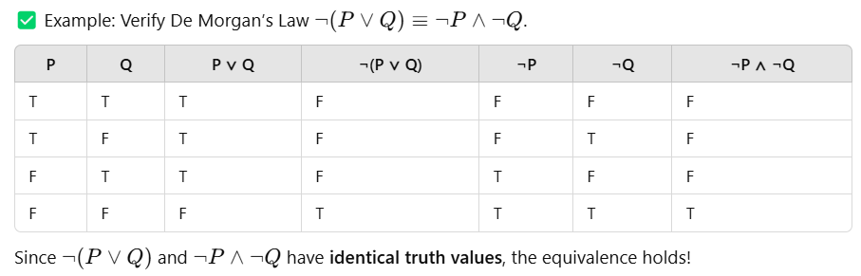
Propositional Equivalences
Example:

Slide 9
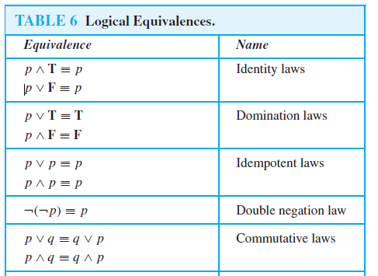
Propositional Equivalences
Properties of Logical Equivalences:

Slide 10
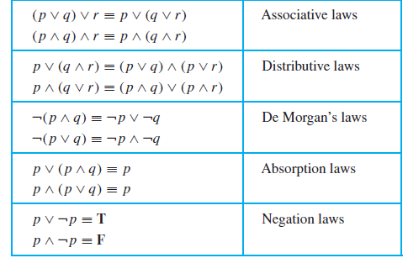
Propositional Equivalences

Slide 11
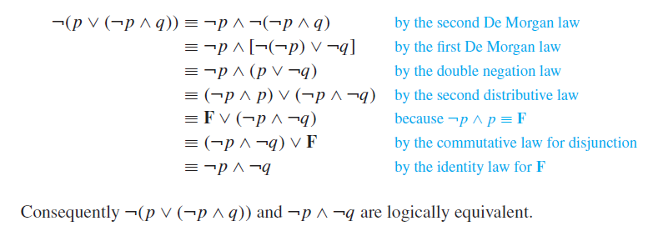
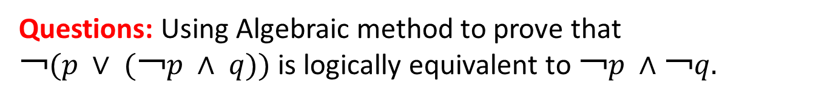
Propositional Equivalences
Questions: Using Algebraic method to prove that
$￢(p ∨ (￢p ∧ q))$is logically equivalent to $￢p ∧￢q.$

Slide 12
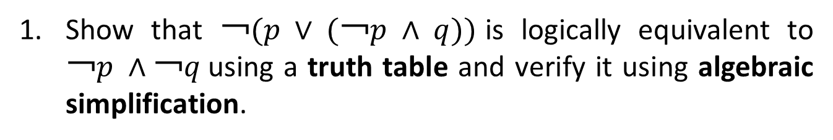
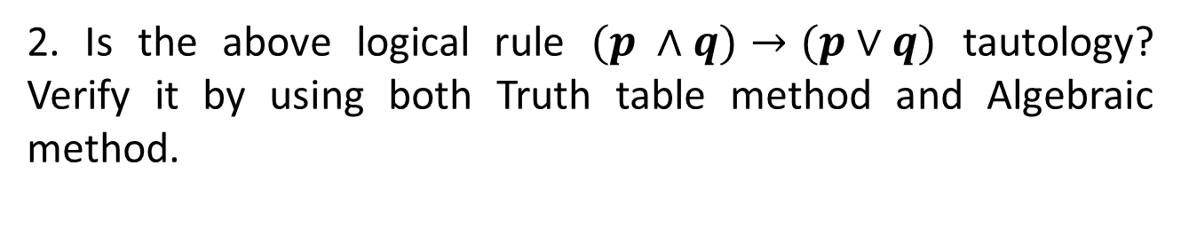
Learning Activity
Show that $￢(p ∨ (￢p ∧ q))$is logically equivalent to $￢p ∧￢q$using a truth table and verify it using algebraic simplification.
2. Is the above logical rule $(p ∧q)→(p∨q)$ tautology? Verify it by using both Truth table method and Algebraic method.

Slide 13
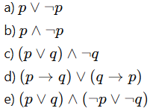
Learning Activity
3. Determine whether the following statements (a) to (e) are logically equivalent.

Slide 14
Applications
Mathematical Proofs – Used in proving theorems and logical deductions.
Computer Science – Helps in Boolean algebra, circuit design, and programming conditions (if-else statements).
Artificial Intelligence – Simplifies logical conditions for reasoning systems.
Digital Logic & Circuits – Used in designing logic gates and optimizing circuits.
5 / 10

Slide 15
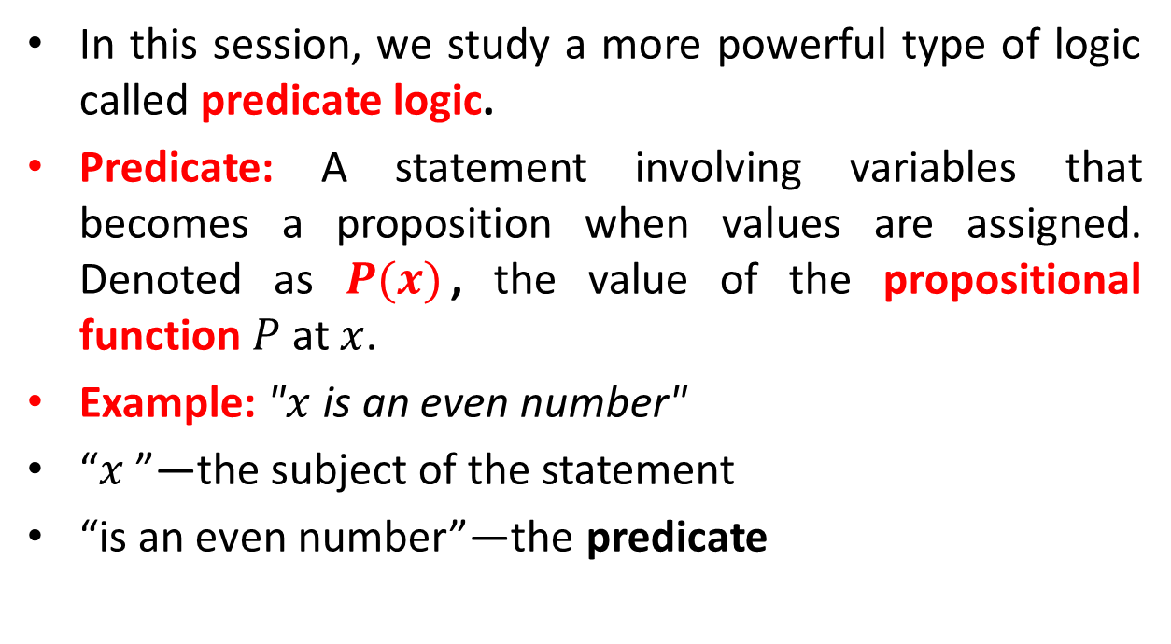
Predicate and Quantifiers in Logic
In this session, we study a more powerful type of logic called predicate logic.
Predicate: A statement involving variables that becomes a proposition when values are assigned. Denoted as $P(x)$, the value of the propositional function $P$ at $x$.
Example: "$x$ is an even number"
“$x$”—the subject of the statement
“is an even number”—the predicate
5 / 10

Slide 16
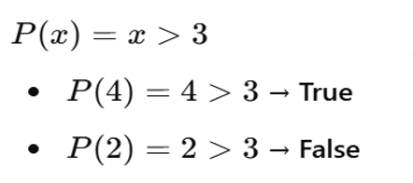

Predicate and Quantifiers in Logic
Example: Determine whether the predicate is true or false for the given values.
$P\left(x\right)=x > 3,$ where $x=2$ and $4.$
What are the truth values of $P(4)$ and $P(2)$?
Solution:
5 / 10

Slide 17
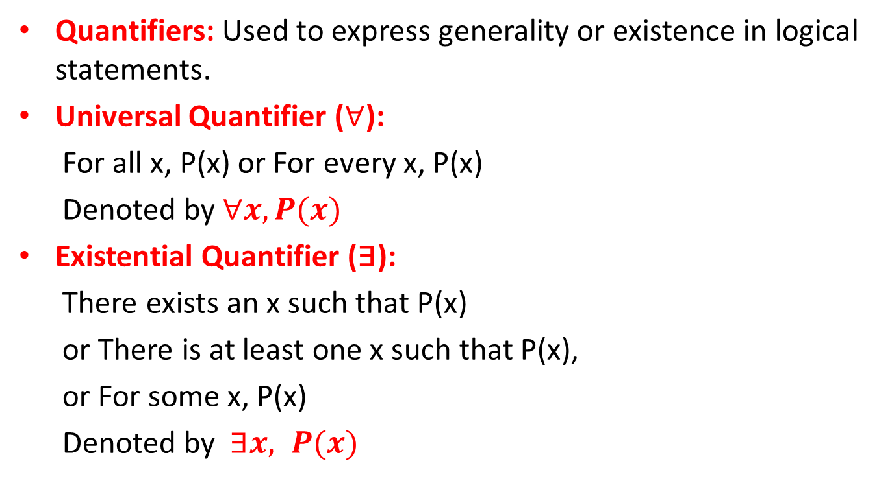
Predicate and Quantifiers in Logic
Quantifiers: Used to express generality or existence in logical statements.
Universal Quantifier ($∀$):
For all x, P(x) or For every x, P(x)
Denoted by $∀x, P(x)$
Existential Quantifier (∃):
There exists an x such that P(x)
or There is at least one x such that P(x),
or For some x, P(x)
Denoted by $∃x, P(x)$
5 / 10

Slide 18
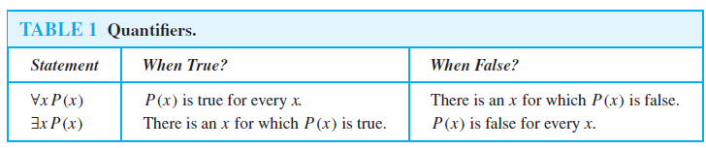
Predicate and Quantifiers in Logic
5 / 10

Slide 19
Learning Activity-2
Let 𝑃(𝑥) be the statement “𝑥 + 1 > 𝑥”. What is the truth value of the quantification ∀𝑥𝑃(𝑥), where the domain consists of all real numbers?
Let 𝑄(𝑥) denote the statement “𝑥 = 𝑥 + 1”. What is the truth value of the quantification ∃𝑥𝑄(𝑥), where the domain consists of all real numbers?
5 / 10

Slide 20
Conclusion
Logical equivalence has been discussed.
Predicate and Quantifiers in logic has been presented.
Related applications and problems are discussed.

Slide 21
Video Links
https://www.youtube.com/watch?v=sPQ3ptUMltA&utm_source=chatgpt.com
https://youtu.be/YYQfYBNlfZg?si=bzEHNN2yciHgzZjb

Slide 22
References
Sr. No. | Author | Name of the Book | Publisher | Year of Publication
1 | Kenneth H. Rosen | Discrete Mathematics and Its Applications | McGraw-Hill | 2019
2 | C. L. Liu | Elements of Discrete Mathematics | McGraw-Hill | 1996
3 | J. P. Tremblay, R. Manohar | Discrete Mathematical Structures with Applications to Computer Science | Tata McGraw Hill | 2001
4 | Kolman, Busby, Ross | Discrete Mathematical Structures | PHI | 2001
5 | Narsingh Deo | Graph Theory with Applications to Engineering and | PHI | 2017

Slide 23
Thanks!!!

